Slide 1
IoT Softwares

Slide 2
Overview
Recognize where programming is needed in the IoT process;
Examine programming logic and identify key programming languages;
Develop a IoT program.

Slide 3
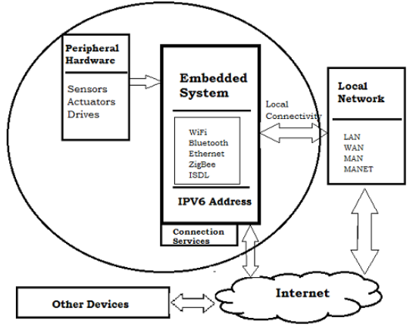
IoT Sofware
Almost IoT devices are embedded systems.
It’s a combination of embedded hardware and embedded software

Slide 4
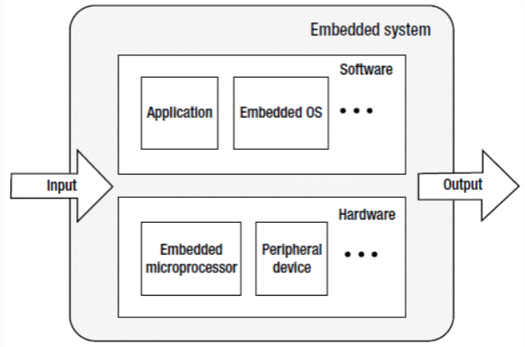
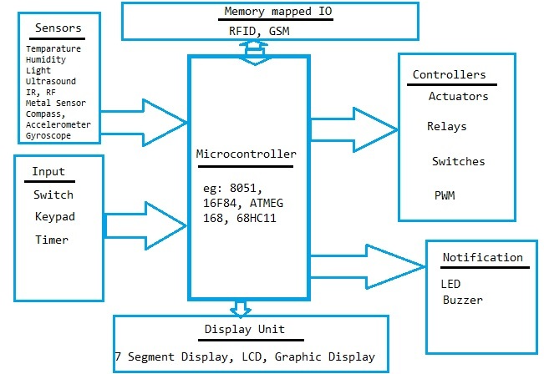
IoT software
Embedded software is the software written to control embedded hardware, normally microprocessor or microcontroller, to process input and scarify output.

Slide 5
IoT software tools
IoT has been raised up by the OSH (OpenSource Hardware)
IoT also has been supported by OSS (OpenSource Software)

Slide 6
IoT software tools
DeviceHive (www.devicehive.com): connects any device via REST API, WebSockets or MQTT. supports various programming languages, including Java, Node.js and Python.
Home assistant (www.home-assistant.io): based on Python scripts, supports almost microprocessor devices.
Kaa (www.kaaproject.org): supports HTTP and MQTT protocols and is an IoT platform

Slide 7
Arduino
An open-source electronics platform based on easy-to-use software and hardware, it’s one of the better-known platforms.
With the development kit and an integrated development environment or IDE.
The cloud system currently is composed of an MQTT broker, which allows developers to send messages from board to board.

Slide 8
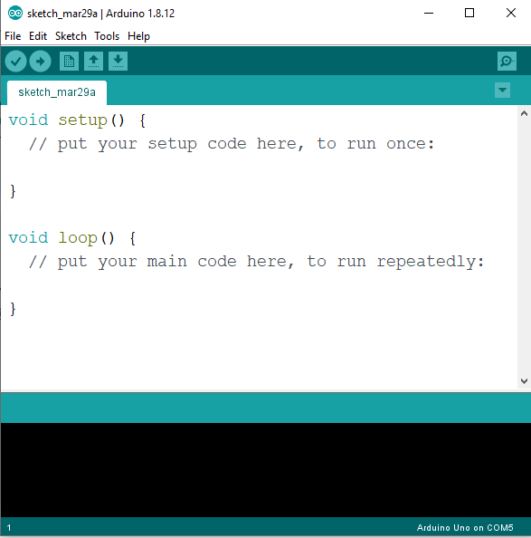
Arduino IDE
Download at https://www.arduino.cc/en/software

Slide 9
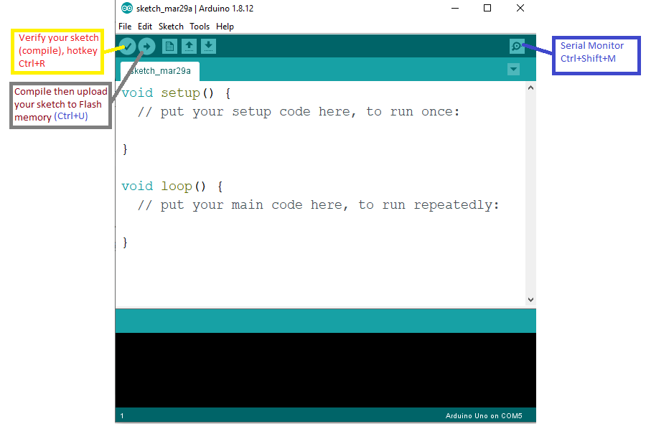
Arduino IDE

Slide 10
Arduino IDE
Upload sketch: a unit of program (sketch) will be transfered to flash memory of IoT device.
Flash memory is a kind of non-volatile memory (NVM).
Arduino IDE uses the USB port to communicate with Arduino devices.
USB port in this case has 2 main functions: one for sketch uploading and one for Serial Monitor. It also supplies power for devices.

Slide 11
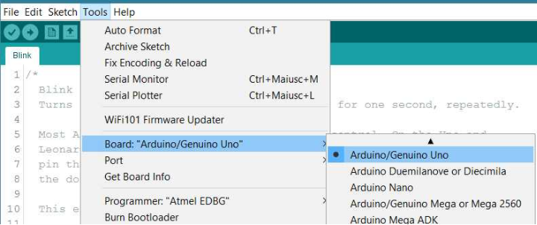
Communication setting
Connect the device to USB port on computer
Set the right board (device)
Select the right COM port (USB to COM)

Slide 12
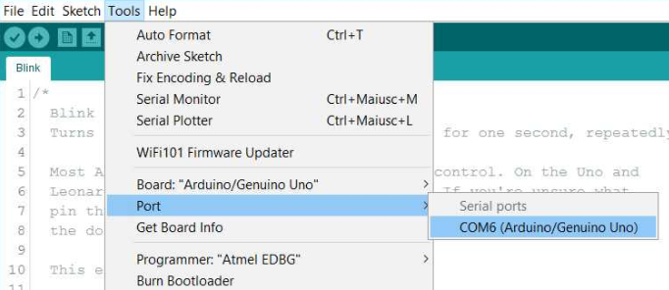
Communication setting

Slide 13
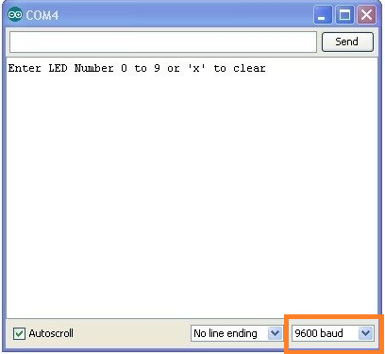
Communication setting
Serial monitor: is a separate pop-up window that acts as a separate terminal that communicates by receiving and sending Serial Data.
In the sketch:
void setup() {
// put your setup code here, to run once:
Serial.begin(9600); // 9600 is the baud rate
// Others setup ...
}
In the Serial Monitor window: set the same baud rate

Slide 14
Sketch
A sketch is the unit of code that is uploaded to and run on an Arduino board
Arduino sketch is based on C++ language
An Arduino sketch can be separated in 3 part:
User defined: variables, functions, include libraries ...
void setup() : used to setup pin mode, serial baud rate ..., run once till reset device power.
void loop() : as a main program, run repeatly untill poweroff.

Slide 15
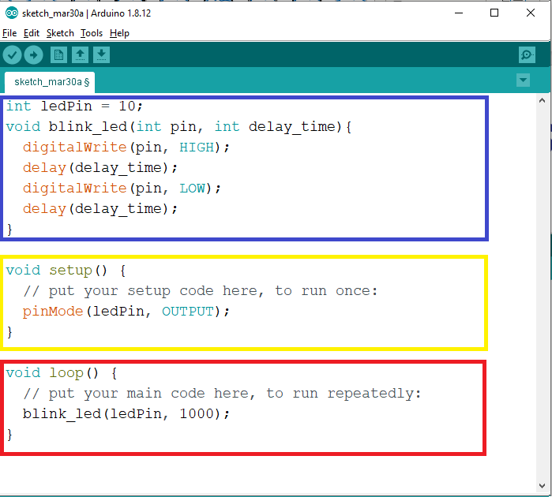
Sketch

Slide 16
Some builtin statements
Setup pin mode:
pinMode(2, INPUT);
pinMode(3, OUTPUT);
Read data from GPIO:
//Read from analog pin, values from 0 to 1023
int sensorValue = analogRead(A0);
//Read from digital pin (set INPUT mode, value is HIGH or LOW)
int sensorValue = digitalRead(2);
Notes:
Ref: https://www.arduino.cc/reference/en/
HIGH: 5V or 3.3V
LOW: 0V

Slide 17
Some builtin statements
Write data to I/O
//Write to analog pin, value from 0 to 255
analogWrite(pin, value)
//write to digital pin (set OUTPUT mode), value is HIGH or LOW
digitalWrite(pin, value)
Delay, very useful function
delay(time_in_milisecond);
Notes:
Ref: https://www.arduino.cc/reference/en/

